Slide 2
Ready for Kindergarten
2021-2022!
Cypress Creek
Elementary School
Principal: Roy Moral
Assistant Principals: Andrea Bryner & Becky Edgar

Slide 3
Welcome Parents We are excited to welcome your child to Kindergarten!
What to expect in or virtual meeting and tour.
School Mission / Vision
Enrollment Information and Needed Documents
What makes our kindergarten program special?
Parent’s role in kindergarten success
A typical day

Slide 4
Cypress Creek Elementary School
Our Vision: To be a learning community dedicated to the success of every student.
Our Mission: To provide quality instruction that empowers students to be successful and responsible for their learning both in and out of the school .

Slide 5
Important Contact Information
School Phone Number: 813-671-5167
School Address: 4040 19th Ave. NE Ruskin, FL 33573
School Website
https://www.hillsboroughschools.org/cypresscreek
School Hours:
Monday 7:10 – 12:55 PM
Tuesday – Friday 7:10 – 1:55 PM

Slide 6
Steps to Enrollment
A parent/legal guardian must complete the registration process and provide the proper documents to the school site where the child will attend.
Your child can attend kindergarten next August as long as she or he turns 5 on or before September 1.
Your child is zoned for a particular elementary school based on your address. Find your assigned school.
For parents who wish to send their child to a school outside of their zoned area, see our choice options.
Notes:
Early Childhood Programs and Kindergarten web page: https://hillsboroughschools.org/doc/2276/bold-beginnings/kindergarten/kindergartenreg/

Slide 7
Documents needed for enrollment
What forms do I need to compete?
Student Enrollment Record Form - SER (provided at the school site or electronically)
Student Residency Form – can be completed ahead of time, supporting documentation is required

Slide 8
Documents needed for enrollment (Continued)
What supporting documents do I need to register for kindergarten?
Birth certificate
Social security card, if available
Florida Physical HRS Form -- Florida Physical HRS form supplied by a doctor dated within 12 months prior to entry in Florida Schools (first day of school)
Florida Immunization Record on HRS hard card (form #680) supplied by a doctor
Two forms of verification of address that prove where you live but are NOT your driver’s license or state-issued ID card (some examples are a utility bill, lease, or a contract to purchase a home)
If a child lives with someone who is not a parent, you may also need to complete a student resident form, which is available at the school
Notes:
Kindergarten Registration Checklist – English: https://hillsboroughschools.org/docs/00/00/22/76/K_Reg_Checklist.pdf
Kindergarten Registration Checklist – Spanish: https://hillsboroughschools.org/docs/00/00/22/76/K_Reg_ChecklistSP.pdf

Slide 9
You child’s success depends on…
GOOD ATTENDANCE!
Children who are present on the first day of kindergarten miss an average of 9 days of kindergarten.
Children who are absent on the first day of kindergarten miss an average of 18 days of kindergarten.
Children who are absent for 18 or more school days in kindergarten have the lowest academic performance in 1st grade.
The Key to Success… Show Up! All Day, Every Day and ON TIME!

Slide 10
Why is it important to be “Kindergarten Ready?”
Children who enter kindergarten “ready to read” are 3 times more likely to graduate on time than those who are “not ready.”
A child’s first school experiences can influence the way he or she relates to others for the rest of life. Success or failure at this stage can affect a child's well-being, self-esteem and motivation, resulting in how they approach school going forward.
The achievement gaps present in the 1st through 3rd grade can be reliably detected before kindergarten (as early as 18 months). By providing opportunities to develop school readiness early, educators can prevent the achievement gap from occurring and support long term success.
Download the Ready For Kindergarten Monthly Checklist for more information.
https://hillsboroughschools.org/docs/00/00/24/24/CountdownKindergartenChecklist.pdf
Notes:
Follow our Ready for Kindergarten monthly checklist to make sure your child is ready for Kindergarten!
https://hillsboroughschools.org/docs/00/00/24/24/CountdownKindergartenChecklist.pdf

Slide 11
Beyond the Skills…
Children must be ready to cope with:
A change in place.
A change in expectations.
Adjustment to a new peer group.
A new authority figure.
A new role as a student.

Slide 12
How can you help with “a change in place?”
Provide opportunities for your child experience a variety of surroundings such as libraries, museums, church and parks etc.
Allow your child to visit a friend’s home.
Make arrangements for your child to visit the school he/she will attend for kindergarten.

Slide 13
How can you help with “a change in expectations?”
Assign your child specific, age-appropriate, tasks and hold him/her accountable for its completion. Create a job chart together and have the child check off completed tasks.
Try to build your child’s stamina (time on task) with activities. Example: Look at books for 5 minutes and build up time from there.
Practice having your child follow two and three step directions. Example: Fold the clothes and the put them in the dresser. OR.. Pick up your toys, put your clothes away and then meet me at the kitchen table.

Slide 14
How can you help with “adjusting to a new peer group?”
Children need to have opportunities to play with others in a group setting (park, museum, child care provider, church, sports, classes).
How can you help with “adjusting to a new authority?”
Provide children opportunities to experience other adults as the authority figure. Have your child visit a friend and his/her parent without you present, have a babysitter in charge from time to time, attend a preschool, story time at the library, day care or church classroom….

Slide 15
How can you help with “adjusting to the role as a student?”
Have your child explore books. Discuss the parts of a book (front, back, cover, title, author). Show your child that we read the text not the pictures and that we read from left to right.
Have you child practice writing the letters.
(Be sure the child is holding the pencil properly.)
Have the child practice writing his/her name and copying words from books.
If needed, start with practicing simple strokes ( / \ X O ).
Play rhyming games and “I Spy” games with letter sounds.
Participate in group activities when possible.
Have your child keep a journal and draw pictures to represent his/her day. Parent can add words if child wants to elaborate!
Birth to Kindergarten Developmental Standards
http://flbt5.floridaearlylearning.com/docs/OEL-SR15BtoK.pdf
Notes:
Florida’s Office of Early Learning Development Standards document –
Birth to Kindergarten: http://flbt5.floridaearlylearning.com/docs/OEL-SR15BtoK.pdf

Slide 16
It is all about EXPOSURE!
Exposure to books and printed materials
Exposure to conversations
Exposure to writing materials
Exposure to other children and adults
Exposure to a variety of locals
(parks, libraries, museums, trips)
Exposure to caring adults

Slide 17
Two Most Important Things
READ, READ, READ to and with your child.
TALK to and LISTEN to your child. Conversation is how children build their vocabulary and develop confidence in communicating with others.

Slide 18
You child’s success depends on…
Behavior that promotes learning
Participation in the classroom family
Active listening throughout the day
Responsibility (getting work done)
Independence
Effort
Self-sufficiency in the restroom

Slide 19
What is Expected from You?
Encourage positive behavior
Create independence: say goodbyes at the door
Review & sign agendas/daily work together
Read with or to your child every night
Ask about the Online Volunteer Application process if interested in volunteering at school
Make sure the teacher knows how your child will be going home (bus, car, walking, private provider van) and notify the office and teacher of any changes
Make sure the office always has your current phone numbers, address, emergency contact, and email address.
Ensure your child arrives at school on time (7:10 – 7:40 AM is arrival)
School begins at 7:40am
Monday Early Release Dismissal 12:55pm
Tuesday – Friday Dismissal 1:55pm
Notify us immediately if you have any concerns.

Slide 20
Uniforms
Old Navy, Wal-Mart, Target, etc.
Tops: White, Navy Blue, Maroon, Grey
Navy and Khaki Dresses, Pants, Shorts, Skirts or Skorts
Appropriate, closed-toe shoes for outside play
Belts secured at the waist so undergarments are not visible.
No embroidered logos needed for tops.

Slide 21
Our Kindergarten Team
Our Kindergarten Team
Mrs. Oley
Mrs. West
Mrs. Hollingshead
Ms. Waddell
Mrs. Anderson
Mrs. Carr-Wilson
Mrs. Calderon (paraprofessional)

Slide 22
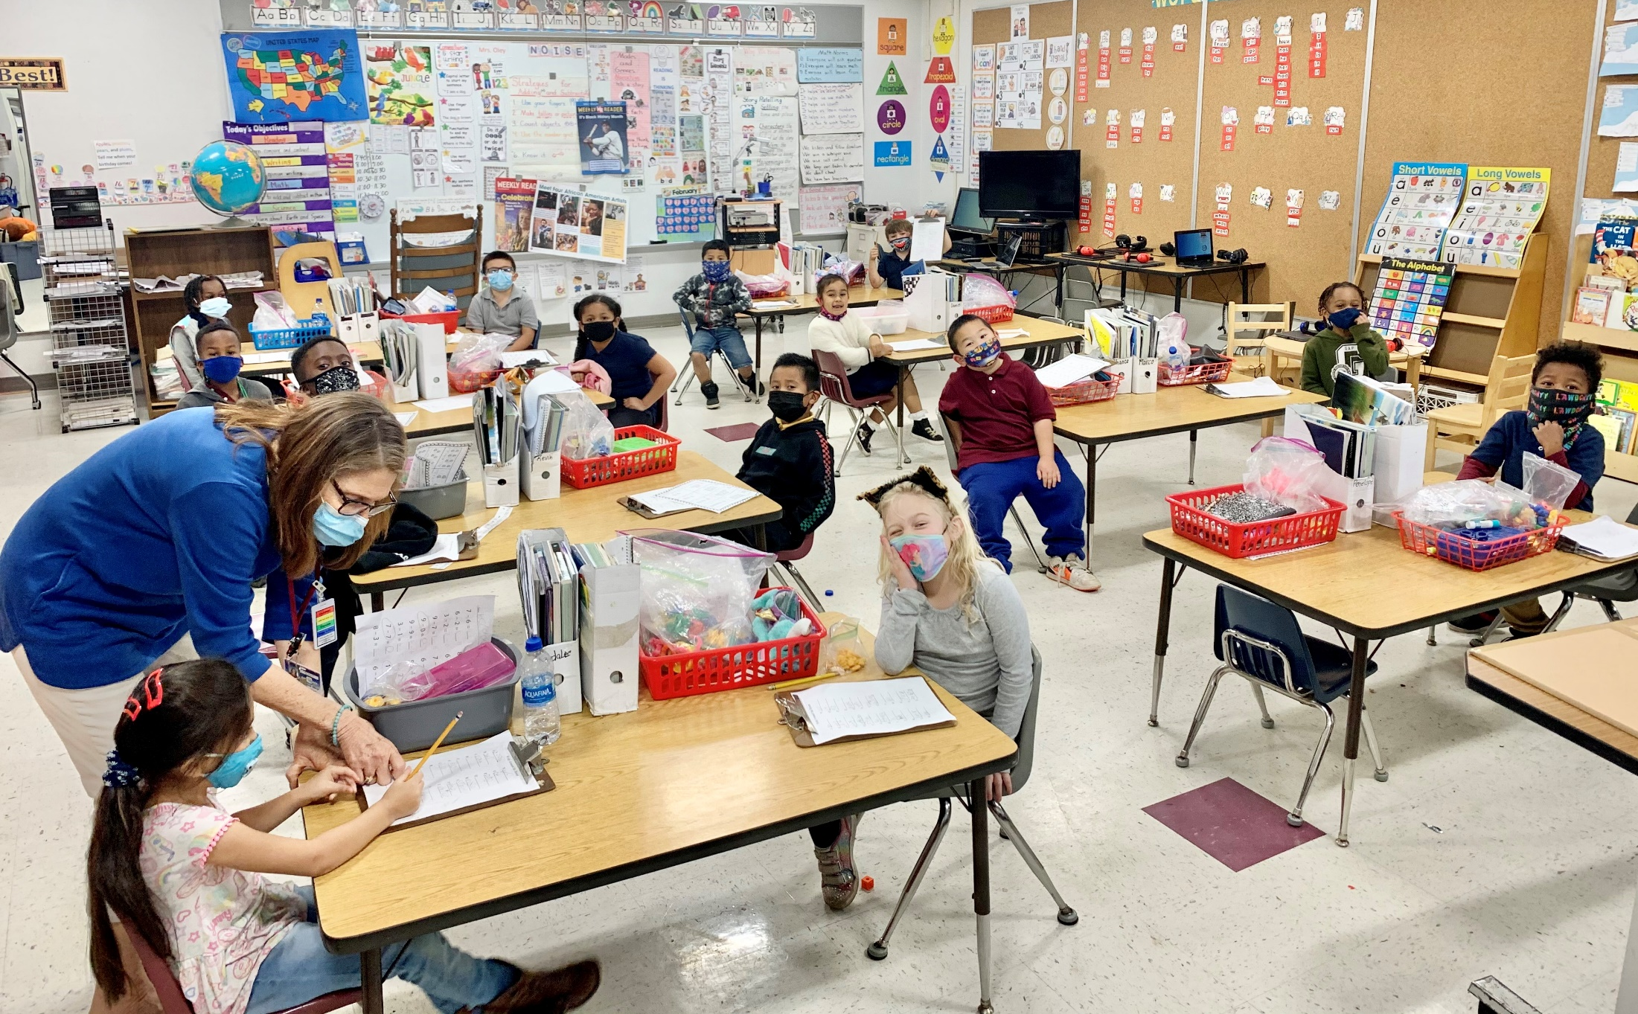
Mrs. Oley

Slide 23
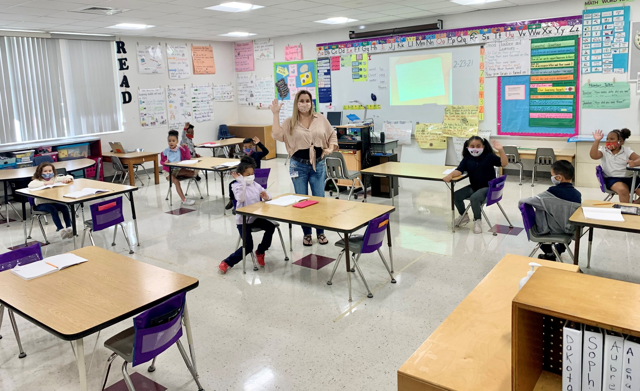
Mrs. West

Slide 24
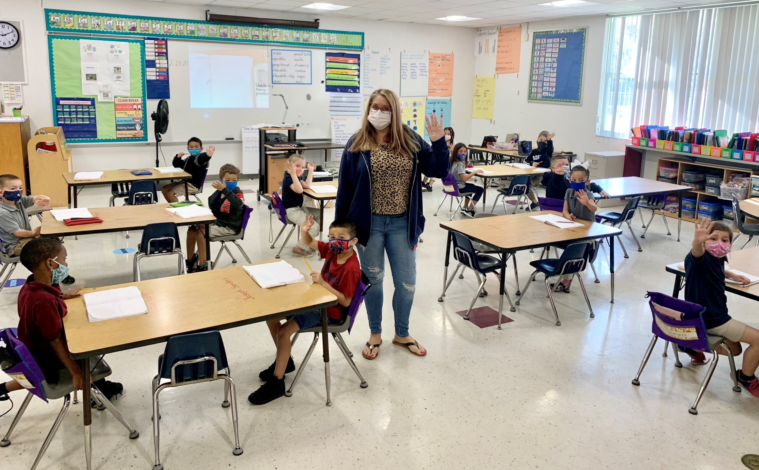
Mrs. Hollingshead

Slide 25
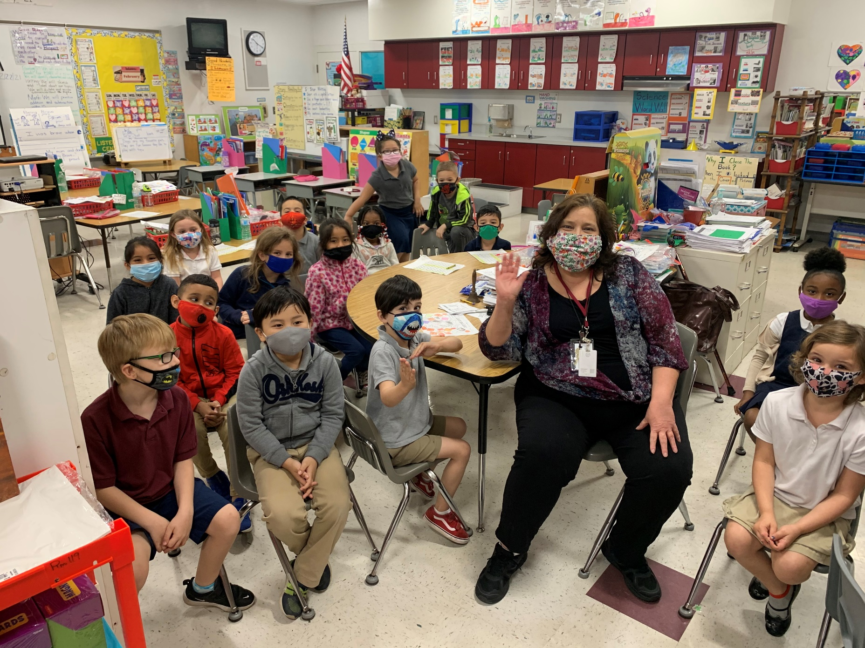
Ms. Waddell

Slide 26
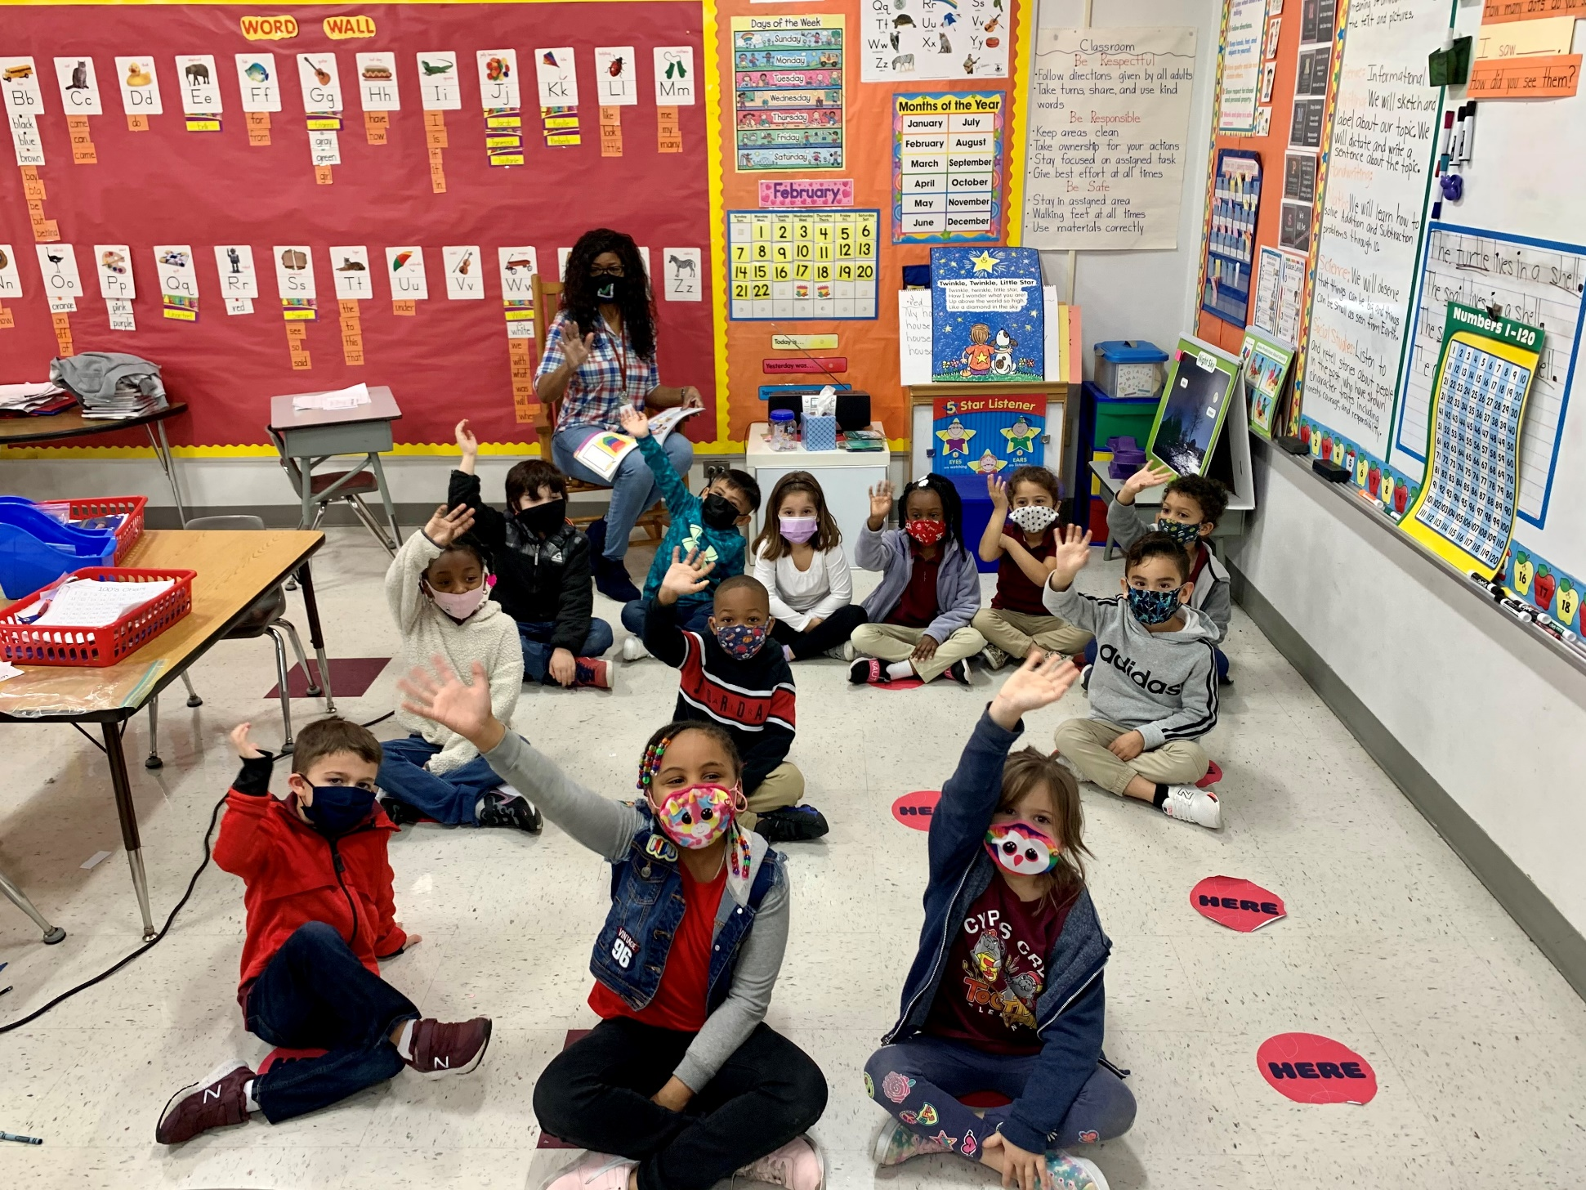
Mrs. Anderson

Slide 27
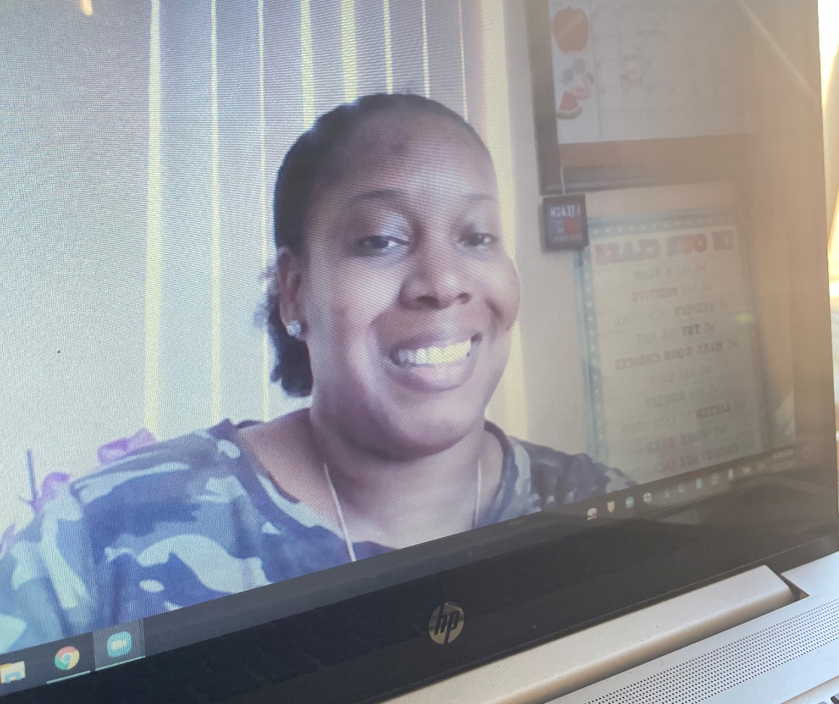
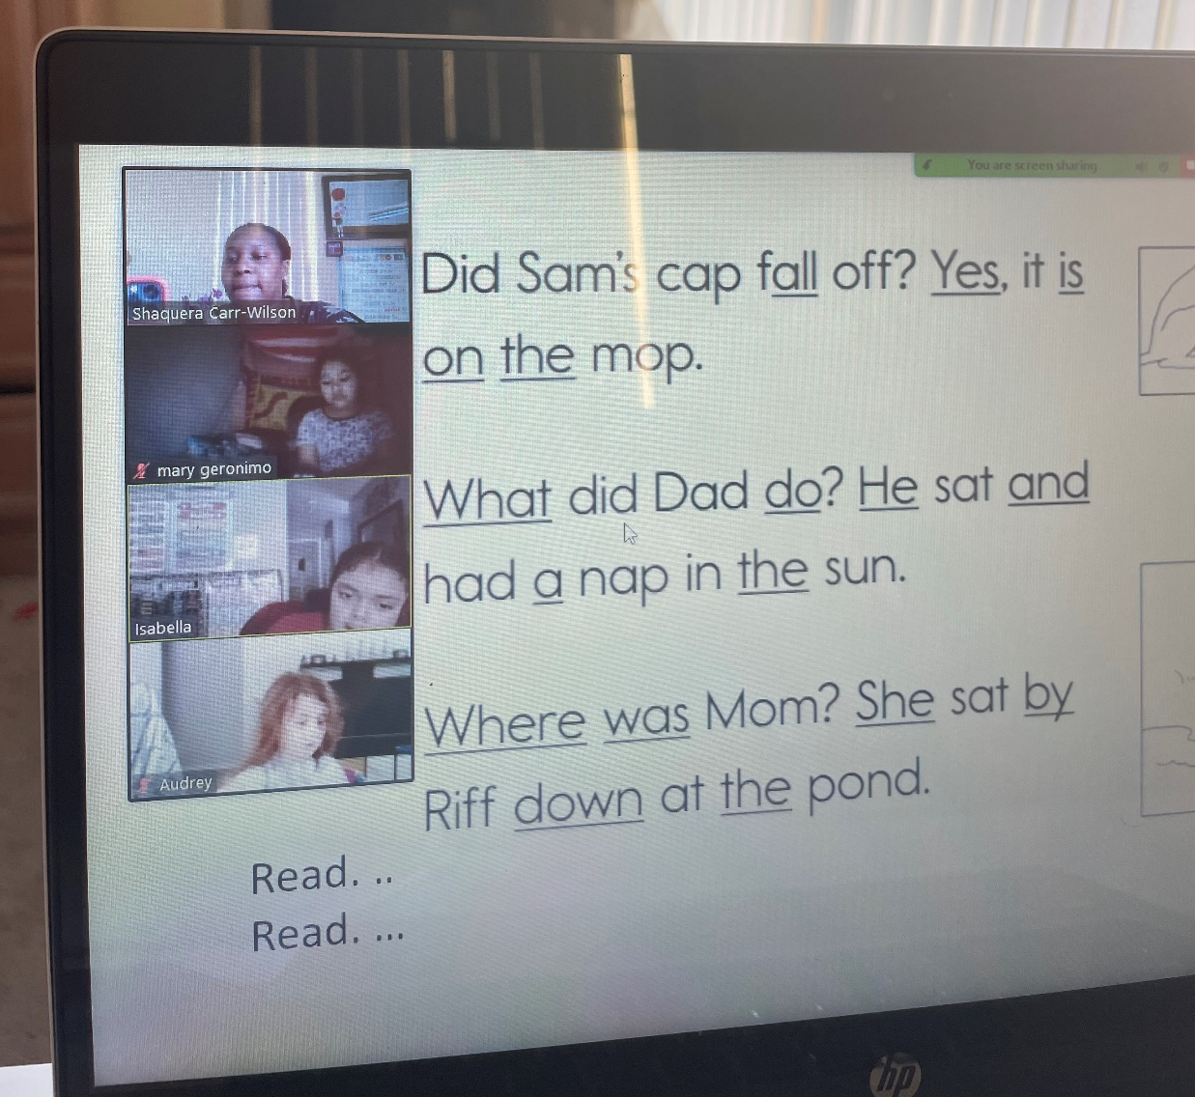
Mrs. Carr-Wilson

Slide 28
Frequently Asked Questions about Kindergarten
Is my child going to be ready? What does he or she need to know?
What are the Florida Standards?
What does that look like in Kindergarten?
What will my child be doing all day?
What can I do to get my child ready?
Florida’s Office of Early Learning Development Standards document – Birth to Kindergarten: http://flbt5.floridaearlylearning.com/docs/OEL-SR15BtoK.pdf
Notes:
Florida’s Office of Early Learning Development Standards document –
Birth to Kindergarten: http://flbt5.floridaearlylearning.com/docs/OEL-SR15BtoK.pdf

Slide 29
Start of the Year Assessments
Star: Star Early Literacy is a state-wide assessment given to all children entering a public school kindergarten in the state of Florida. It will be given during the first 30 days of school.
i-Ready: i-Ready is an online computer program that students will utilize throughout the year. Students will participate in lessons as well as diagnostic measures.

Slide 30
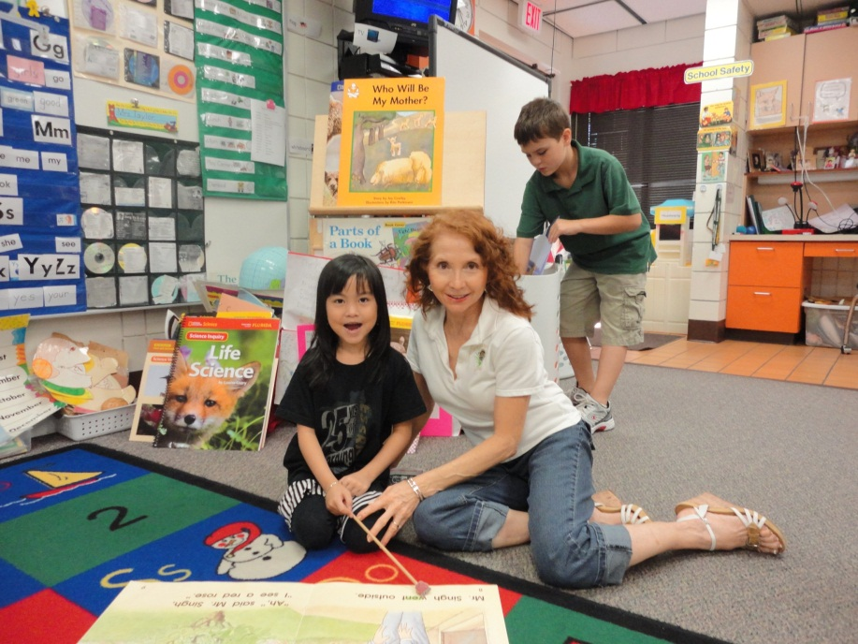
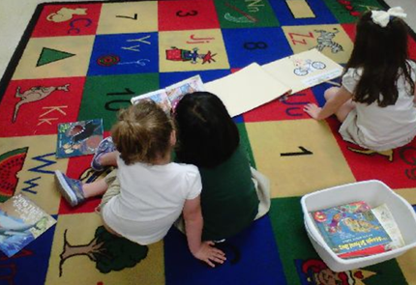
Reading
Read Alouds
Shared big books
Interactive read alouds
Small groups
Sight words
Independent Practice

Slide 31
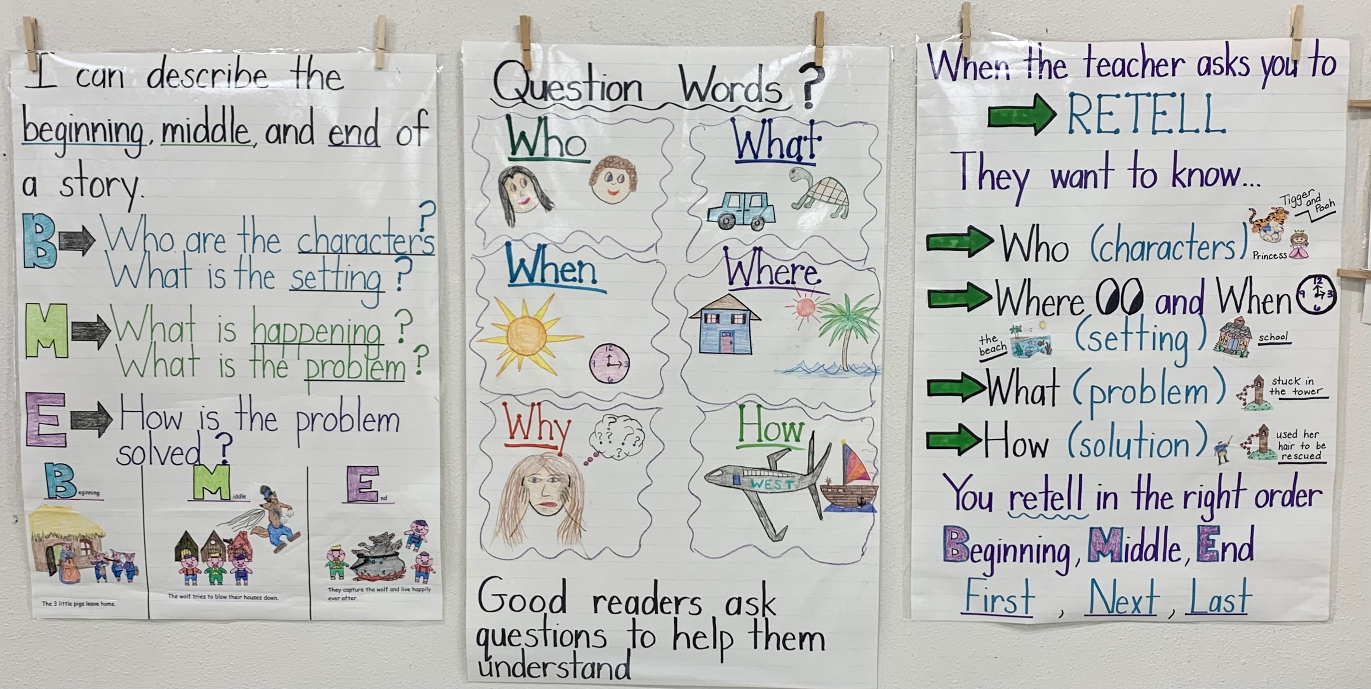
Reading Anchor Charts

Slide 32
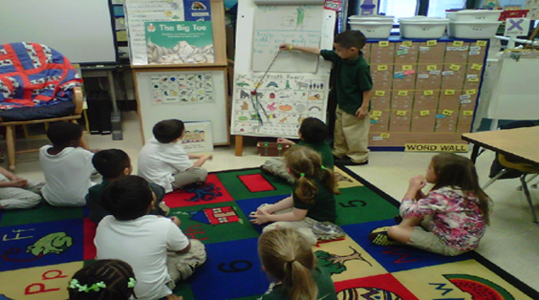
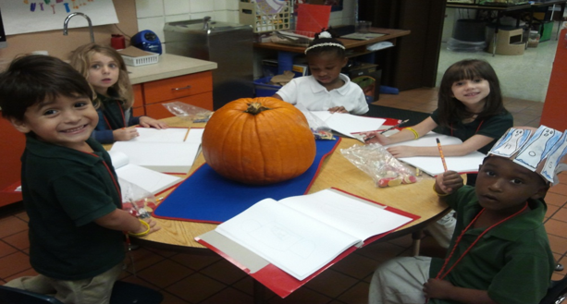
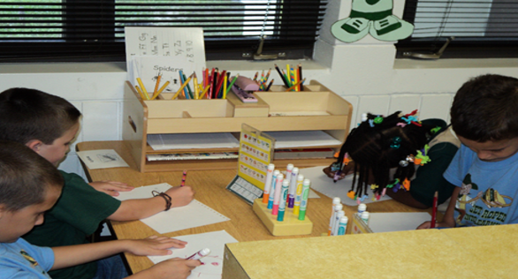
Writing
Modeled
Shared
Guided
Independent

Slide 33
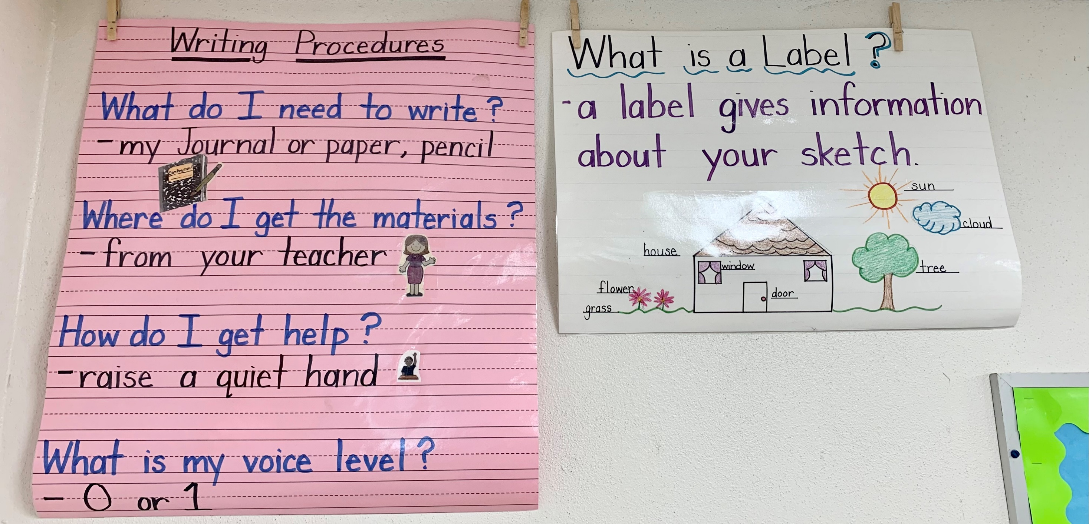
Writing Anchor Charts

Slide 34
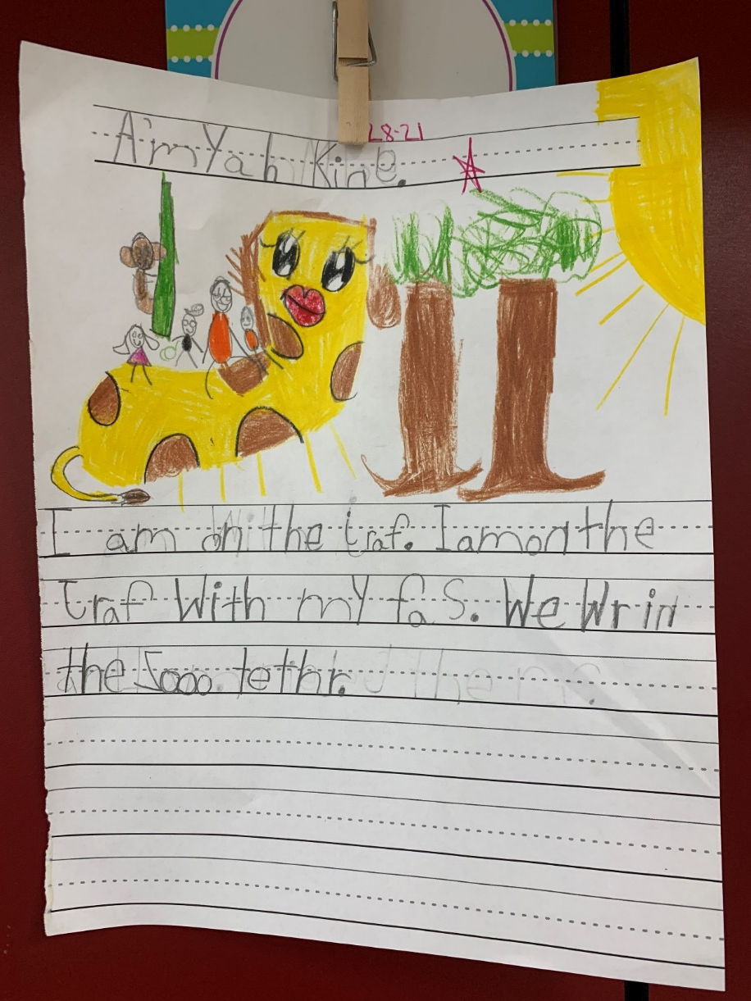
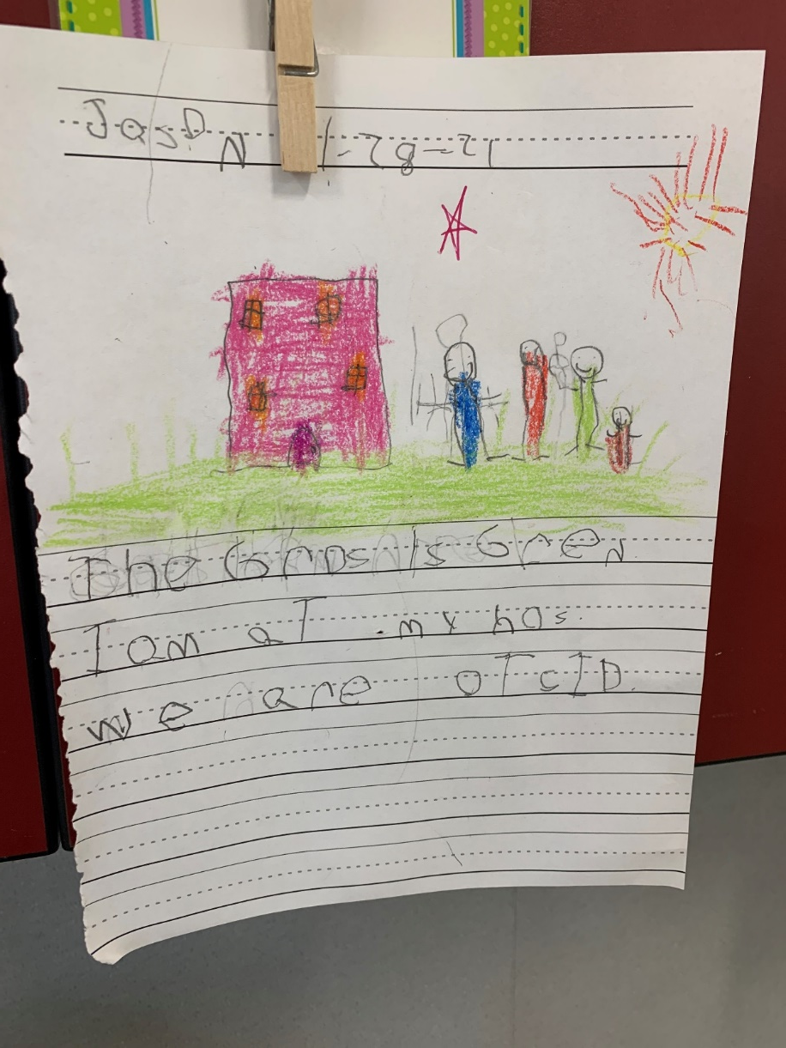
Writing Samples

Slide 35
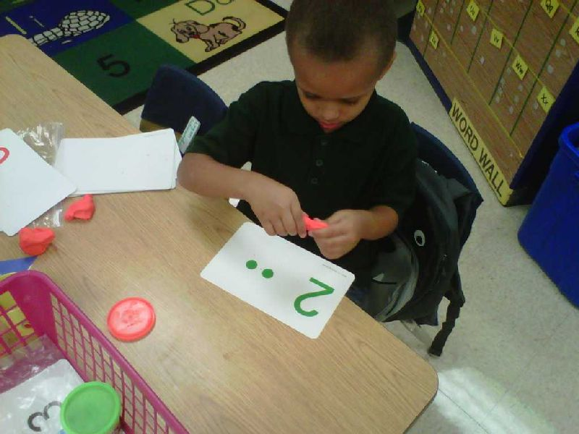
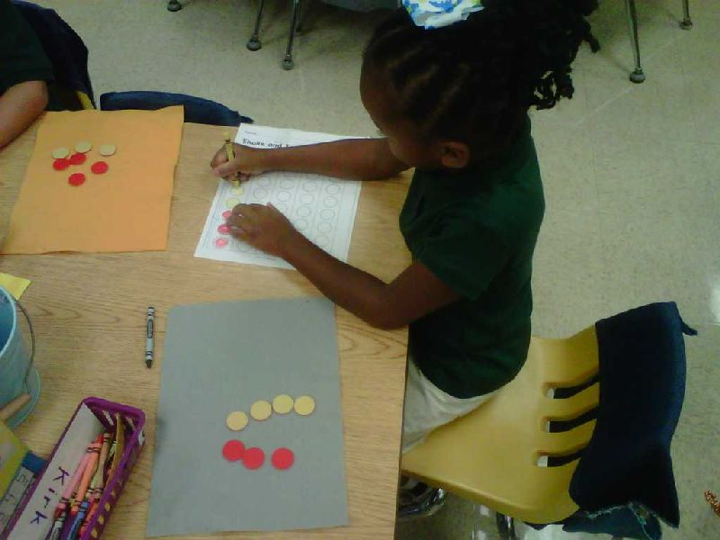
Math
Hands-on
activities to
deepen understanding

Slide 36
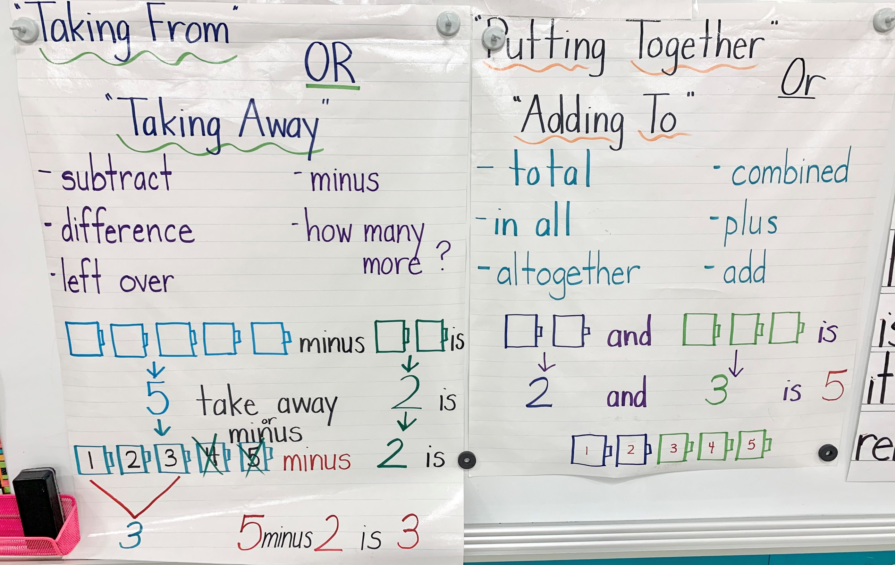
M
A
T
H

Slide 37
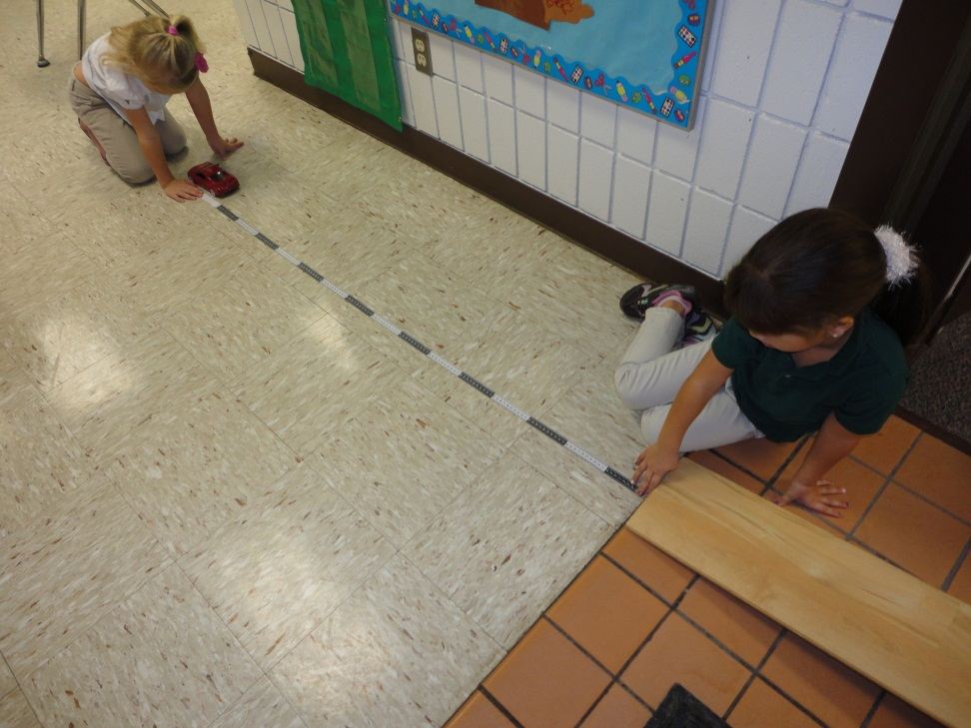
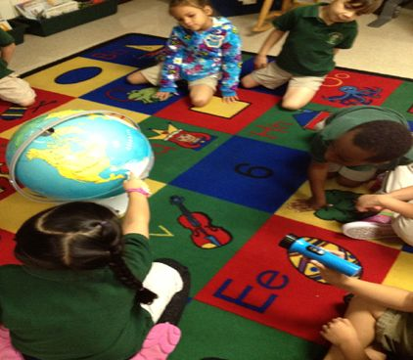
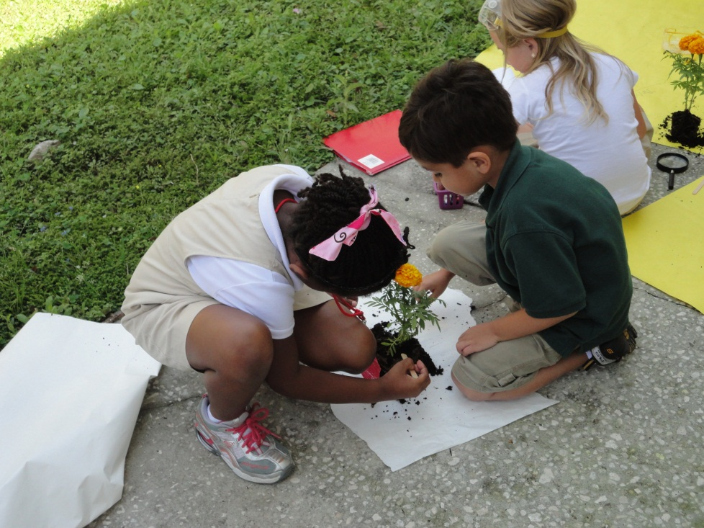
Science
Observing using the five senses
Hands-on activities for deeper understanding
Physical Science
Life Science
Earth Science

Slide 38
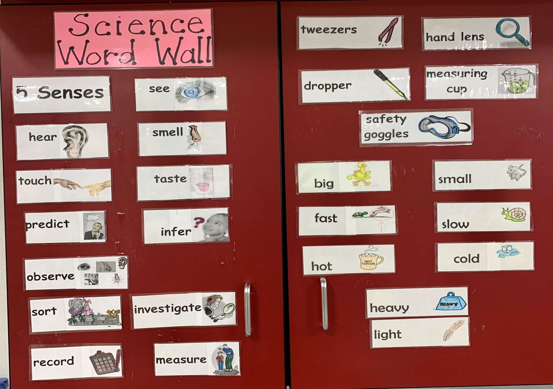
S
C
I
E
N
C
E

Slide 39
Social Studies
Calendars, Weather, Holidays, and American Heroes
Rules and Laws, Good Citizens
Jobs and Money, Wants and Needs, Families
Maps and Globes, Symbols of America

Slide 40
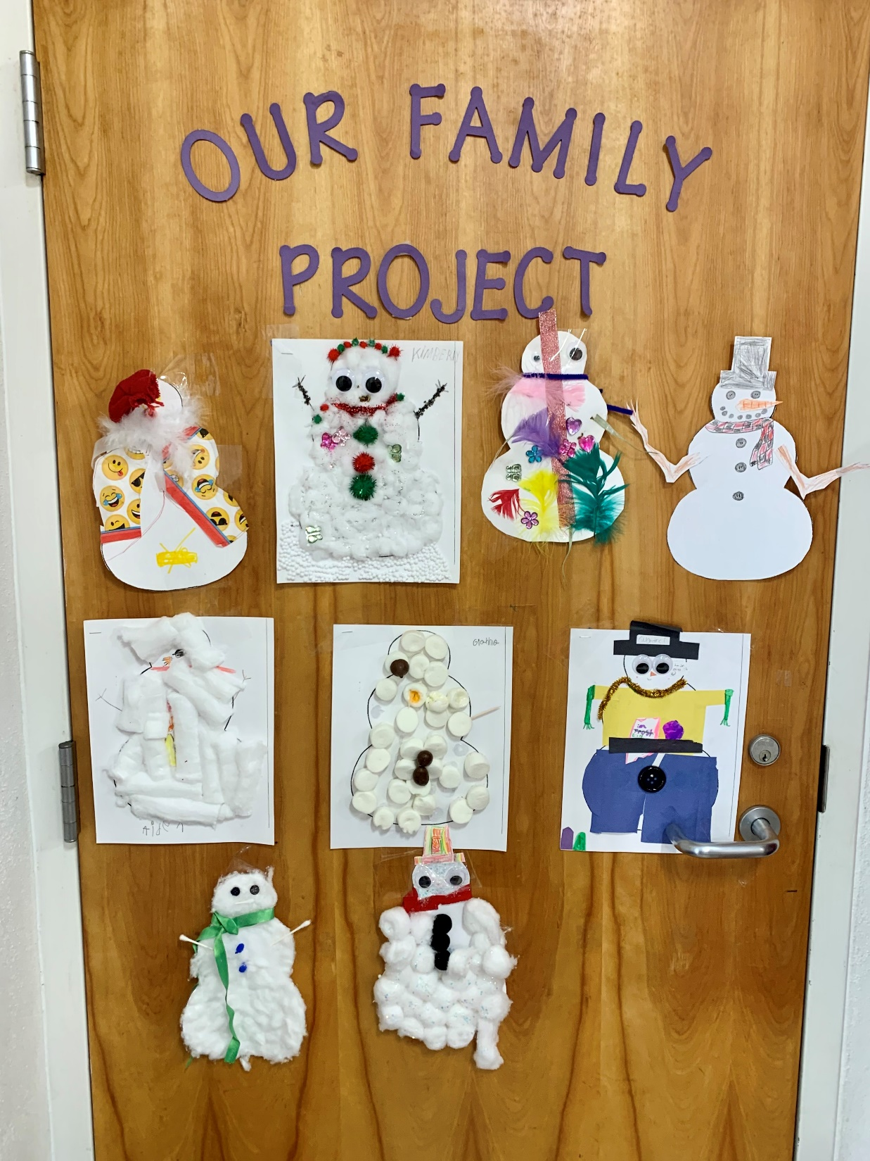
Social Studies
Family involvement
projects throughout
the year.

Slide 41
Mrs. Jolene – School Nurse
Entry Vaccinations and Physicals
Medications
Nutrition
Sleep
Hearing and Vision Screening

Slide 42
Mr. Ranalli – ESE Specialist Mr. Perez – Speech/Language Ms. Polanco – Speech/Language Ms. Washington – Speech/Language Ms. Speech – Speech/Language
Childfind (before child is registered)
Screen & Evaluate (3-5 years old) 813-837-7788
Difficulty understanding child’s speech
Child has difficulty engaging in conversational speech
Child is currently receiving Speech and/or Language Services (private)
Speech Screenings
MTSS Process

Slide 43
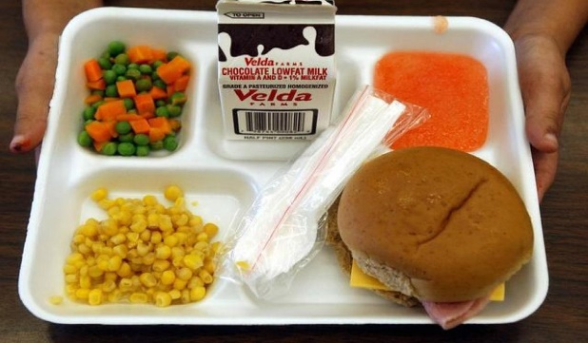
Mrs. Medina - Lunchroom Manager
Student numbers (7-digits)
Universal Breakfast
Free for all students
Served between 7:10 a.m. - 7:40 a.m.
Free and Reduced Lunch
Forms available upon registration/online registration available
Current lunch price is $2.25 (2021-2022 prices are subject to change)
Payment options: Online Payment is available
Online Lunch Registration, click below.
Online Lunch Application

Slide 44
Ms. Irizarry – English Language Learner Program
SER form – Home Language Survey section
Screeners
Small Group Instruction for children who speak other languages

Slide 45
Mrs. Miesner – School Counselor Ms. English – School Counselor Dr. Roth – School Psychologist Mrs. Fogle – School Social Worker Ms. Psychologist – School Psychologist
School-wide discipline plan
Guidance services
Social work services
Psychological services

Slide 46
Younger siblings and neighbors
Head Start
Head Start is a federally funded, comprehensive, child development program that encompasses all aspects of a child's development and learning. The program serves children ages 3 to 4 years old. Eligibility is based on income.
https://www.sdhc.k12.fl.us/doc/2601/early-childhood-programs-and-kindergarten/head-start/hsapply/
Florida's Voluntary Prekindergarten Program (VPK)
All of Florida's four-year-olds have access to free, quality prekindergarten programs.
5 years old on or before September 1
https://www.sdhc.k12.fl.us/doc/list/early-childhood-programs-and-kindergarten/voluntary-prekindergarten/225-1241/
Notes:
Follow our Ready for Kindergarten monthly checklist to make sure your child is ready for Kindergarten!
https://hillsboroughschools.org/docs/00/00/24/24/CountdownKindergartenChecklist.pdf

Slide 47
Summer VPK Program
FREE Summer program to ensure kindergarten
readiness (dates and times to be determined)
Approximately 20 sites throughout the district
(should be available by Late Feb/Early March)
Registration requirements: proof of birth, proof of residence and a
shot record
Registration at open summer VPK sites begins May, 2021
Child must be eligible to start kindergarten August, 2021
(5 years old by September 1, 2021)
Child may not have attended a school-year VPK Program
VPK Hotline: 813-272-4840

Slide 48
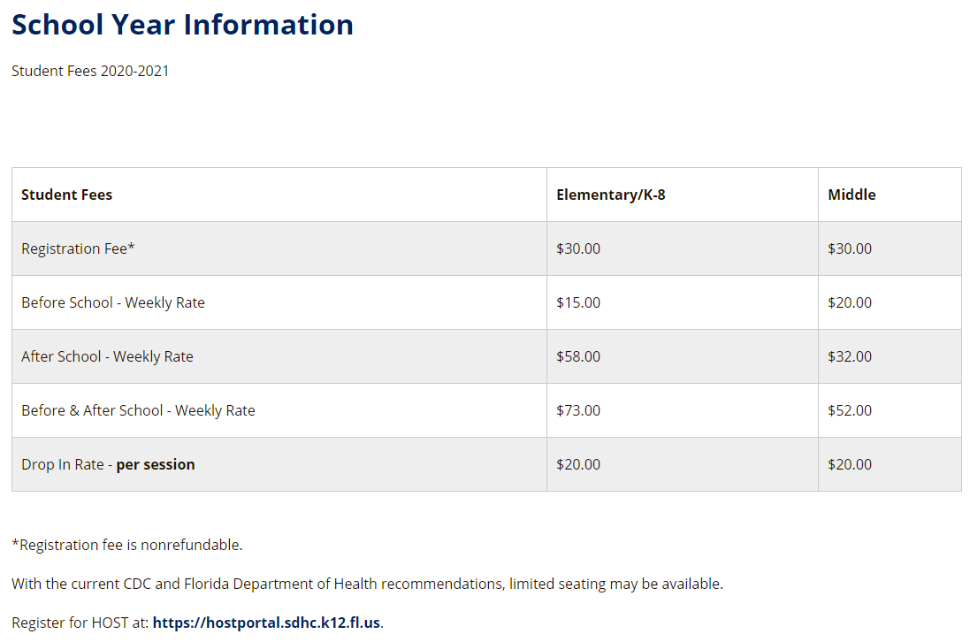
HOST
813-744-8941 Ext. 3
You can not register for HOST until your child has a 7-digit district ID number

Slide 49
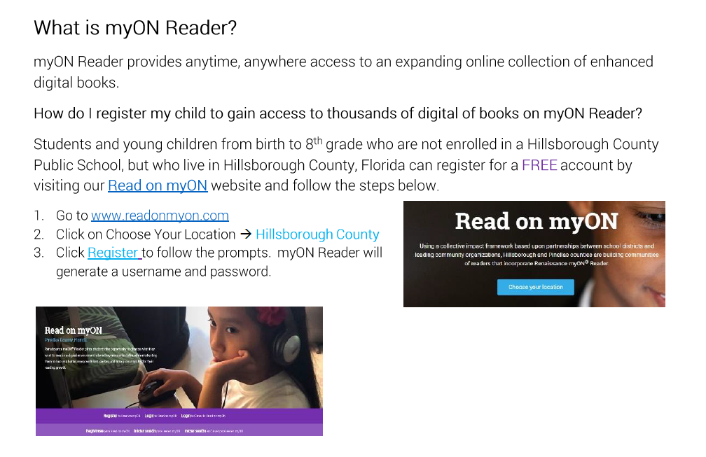
Free myON account!

Slide 50
Vroom – FREE app!
Vroom is an app that helps busy parents make the most of the time they have. Turn fun, everyday moments into brain building moments for your child.
http://www.joinvroom.org/

Slide 51
Questions and Answers
Notes:
The READY FREDDY ™ logo and trademark is owned by the University of Pittsburgh Office of Child Development, and is being used under license. ReadyFreddy.org

